Slide 1
Message Authentication Codes (MACs) and Hashes
Zaobo He
Notes:
317%52 = 5. since 5 and 52 are co-prime .then 317 and 52 are coprime.
determine all number in [2, n -1], whether exist a m, such that n%m ==0
int isPrime(int n) {
int i;
for (i = 2; i < n; ++i) {
if (n % i == 0) return 0;
}
return 1;
}

Slide 2

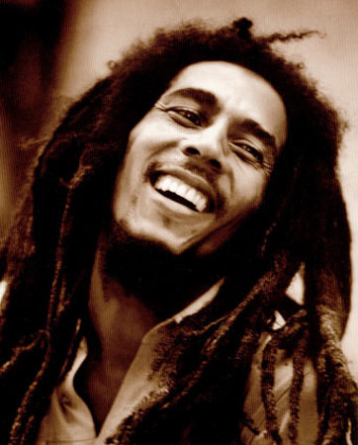


M
Message:
I love you
Message:
I hate you
M
Alice
Bob
Ha! Bob should feel sad
Eve
Goal 1: Integrity
Eve should not be able to alter M.

Slide 3
M
Alice
M
Bob
Eve
Goal 2: Authenticity
Eve should not be able to forge messages as Alice

Slide 4
Message Integrity/Authenticity
We cannot have data authenticity without integrity.
Integrity: data authenticity
Authenticity: source authenticity
Goal: authenticity and integrity (not secrecy)
Example:
Protecting public files on disk
Protecting banner ads on web pages

Slide 5
Message Authentication
Message authentication is concerned with:
Protecting the integrity of a message
Validating identity of originator

Slide 6




Symmetric Cipher for Authentication
bit-flipping attack
0
=10111101
0
10111101 =
10001111
=00110010
00110010 =
用户
网站服务器
The one-time pad cannot guarantee integrity

Slide 7
Symmetric Cipher for Authentication
Malicious code injection attacks
m
= m
⊕evil
m⊕k
⊕evil
= k
k =
用户
网站服务器
The one-time pad cannot guarantee integrity

Slide 8


Public-Key Cipher for Authentication
Only provides confidentiality:
Part A
Part B
A’s private key
A’s public key
B’s public key
A’s private key
PR_{A}
PU_{A}
PU_{B}
PR_{B}
Encrypt with PU_{B}
Decrypt with PR_{B}

Slide 9
Public-Key Encryption for Authentication
Only provides authenticity:
Part A
Part B
A’s private key
A’s public key
B’s public key
A’s private key
PR_{A}
PU_{A}
PU_{B}
PR_{B}
Encrypt with PR_{A}
Decrypt with PU_{A}

Slide 10
Public-Key Encryption for Authentication
Provides both confidentiality and authenticity:
Part A
Part B
A’s private key
PR_{A}
A’s public key
B’s public key
B’s private key
PR_{B}
PU_{A}
PU_{B}
Encrypt with PR_{A}
Decrypt with PR_{B}
Encrypt with PU_{B}
Decrypt with PU_{A}

Slide 11
Public-Key Encryption for Authentication
If public-key encryption is used:
Encryption provides no confidence of sender, since anyone potentially knows public-key.
However, if sender signs message using their private-key, then encrypts with recipient's public key, provides both confidentiality and authentication.
Again, need to recognize corrupted messages.
But at cost of two public-key encryptions on message.

Slide 12
Message Authentication Code (MAC)
A message authentication code (MAC):
Also known as a cryptographic checksum,
Is an authentication technique involving the use of a secret key to generate a small fixed-size block of data.
Provide integrity as well as authentication
A MAC, sometimes known as a tag
Notes:
A checksum is a small-sized data block derived from a message for the purpose of detecting errors that may have been introduced during its transmission or storage.
In cryptography, a message authentication code (MAC), sometimes known as a tag, is a short piece of information used to authenticate a message—in other words, to confirm that the message came from the stated sender (its authenticity) and has not been changed.
The MAC value protects both a message's data integrity as well as its authenticity, by allowing verifiers (who also possess the secret key) to detect any changes to the message content.

Slide 13
Message Authentication Code (MAC)
Generated by an algorithm that creates a small fixed-sized block
Depending on both message and some key.
Like encryption although need not be reversible.
T = MAC(K, M)
Appended to message as a signature.
K
M
T
Notes:
1. A (digital) signature is created with a private key and verified with the corresponding public key of an asymmetric key-pair.

Slide 14
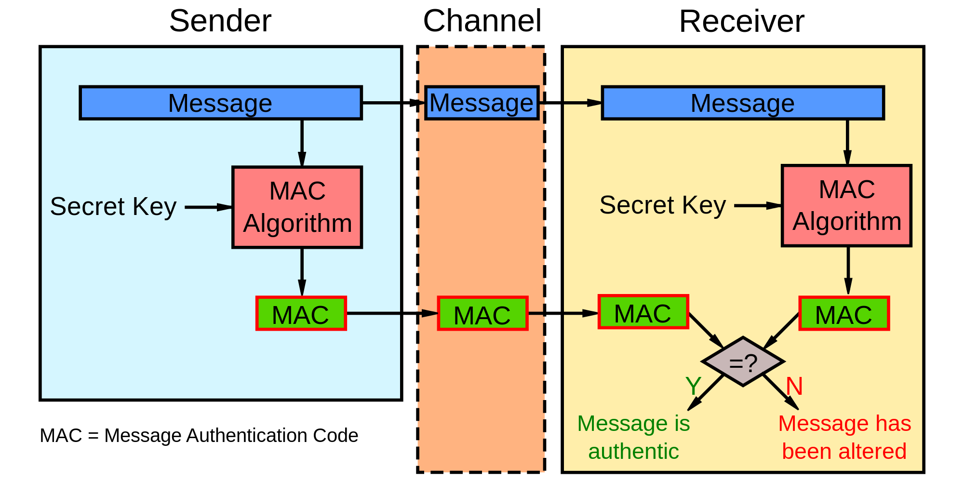
Message Authentication Code (MAC)
Receiver performs same computation on message and checks it matches the MAC.
Provides assurance that message is unaltered and comes from sender.

Slide 15
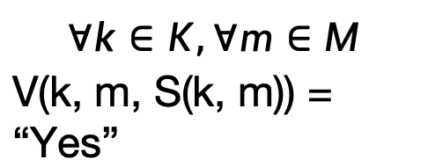
Message integrity: MACs
k
k
message m
tag
Alice
Bob
Generate tag:
tag ← S(k, m)
Verify tag:
V(k, m, tag) = `yes’
?
Def: MAC I = (S,V) defined over (K,M,T) is a pair of algs:
S(k,m) outputs t in T
V(k,m,t) outputs `yes’ or `no’
$$∀k∈K,∀m∈M$$
V(k, m, S(k, m)) = “Yes”
Even though the message is gigabytes long, the tag is actually very, very short.
Notes:
They have a shared key, K, which is not known to the attacker, but know to both of them
Alice use a MAC signing algorithm, we will denote it by S, and it produces a very short tag. The tag could be like 90bits or 100bits or so on.
Even though the message is gigabytes long, the tag is actually very, very short.
Then she appends the tag to the message and sends the combination of the two to Bob.
Bob then runs what’s called a MAC verification algorithm on this tag, and it says basically yes or no, depending on whether the message is valid or whether it’s been tampered with.

Slide 16
How about CRC or Parity Check - Keyless
message m
tag
Alice
Bob
Generate tag:
tag ← CRC(m)
Verify tag:
V(m, tag) = `yes’
?
cyclic redundancy check (CRC): get a short check value attached, based on the remainder of a polynomial division of their contents
Example: 6 23 4，binary code is: 00000110,00010111,00000100.
Divide by 9 (1001), the reminder is: 0001
Then the transmitted data is: 6 23 4 1
Example: parity check code: 0001 1010, for odd parity check, then 0001 1010 0.
Notes:
A cyclic redundancy check (CRC) is an error-detecting code commonly used in digital networks and storage devices to detect accidental changes to raw data.
So imagine, instead of using a key to generate the tag, Alice uses a CRC algorithm which is keyless.
Then Bob will basically verify that the CRC is still correct.
The problem with this is very easy for an attacker to defeat. In other words, an attacker can very easily modify the message and tag, and fool Bob into thinking that the new message is a valid one,
Attacker will simply block them, and then he’ll produce his own messages, M’, and compute CRC(M’), and send the concatenation of the two over to Bob.
Bob will run the verification algorithm. Verification will work properly.
The problem is because CRC doesn’t have a key, there is no difference between Alice and attacker.
Once we introduce a key, now Alice can do something that the attacker can’t do. As a result, she might be able to compute a tag that the attacker can’t modify.
So the point to remember is that CRC is designed to detect random errors, not malicious errors

Slide 17
How about CRC
message m
tag
Alice
Bob
Generate tag:
tag ← CRC(m)
Verify tag:
V(m, tag) = `yes’
?
Attacker can easily modify message m and re-compute CRC.
CRC designed to detect random (accidental) changes to raw data, not malicious errors.

Slide 18
Secure MAC Game
Chosen message attack
Challenger
1. k = KeyGen(l)
3. Compute i in 0...q: t_{i} = S(m_{i}, k)
5. b = V(m,t,k)
Adversary A
2. Picks m₁, ..., m_{q}
4. picks m not in m₁,...,m_{q} Generates t
m₁,...,m_{q}
t₁,...,t_{q}
m,t
existential forgery if b=“yes”
b = {yes,no}
Security goal: A cannot produce a valid tag on a message
Even if the message is gibberish
Notes:
As usual, we define security in terms of the attacker’s power. What can the attacker do?
The attacker’s power is what’s called a chosen message attack,. In other words, the attacker can give Alice arbitrary messages of his choice.
You might wonder, why would Alice ever do that?
For example, the attacker might send Alice an email, Alice might want to save the email to disk in a way that will prevent someone from tempering with the disk. So she’ll compute a tag on the message.
Later on, the attacker might steal Alice’s disk.
What he’s trying to do is to produce some new valid message tag there
The existential forgery means that the attacker cannot produce a new message/tag pair, even for a message that’s completely gibberish,

Slide 19
Secure MACs
For a MAC I=(S,V) and adv. A define a MAC game as:
Def: I=(S,V) is a secure MAC if for all “efficient” A: Adv_{MAC}[A,I] = Pr[Chal. outputs 1] is “negligible”
m₁ ∈ M
m₂
, …, m_{q}
Chal.
Adv.
k←K
t₁ ← S(k,m₁)
t₂
, …, t_{q}
(m,t)
b
b=1 if V(k,m,t) = `yes’ and (m,t) ∉ { (m₁,t₁) , … , (m_{q},t_{q}) }
b=0 otherwise

Slide 20
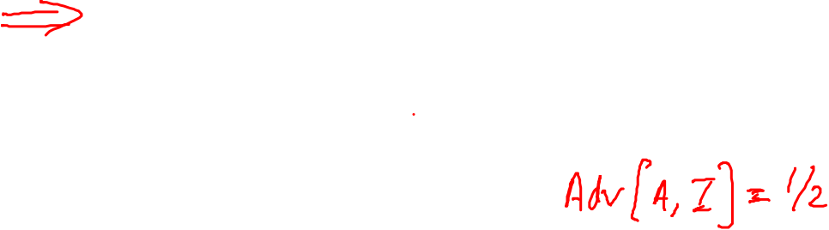
Let I = (S,V) be a MAC.
Suppose an attacker is able to find m₀ ≠ m₁ such that
S(k, m₀) = S(k, m₁) for ½ of the keys k in K
Can this MAC be secure?
Yes, the attacker cannot generate a valid tag for m₀ or m₁
No, this MAC can be broken using a chosen msg attack
It depends on the details of the MAC
Notes:
In other words, if you choose a key at random, with probability one half, the tag of the message m0 will be same as the tag of the message m1.
Emphasize that the attacker doesn’t know what the tag on m0 and m1 is. All he knows is that the two messages happen to have the same tag with probability one half.
he first get: (m0, T), (m1, T) this is a valid existential forgery. The attacker wins the game with advantage one half.

Slide 21
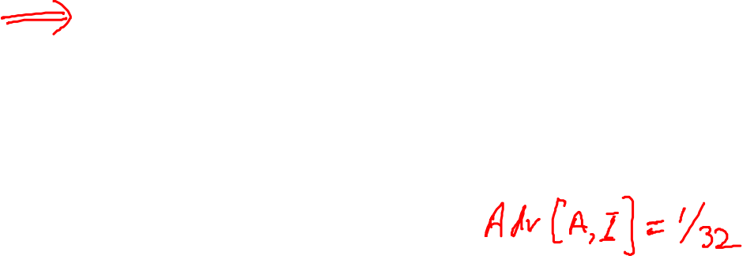
Let I = (S,V) be a MAC.
Suppose S(k,m) is always 5 bits long
Can this MAC be secure?
No, an attacker can simply guess the tag for messages
It depends on the details of the MAC
Yes, the attacker cannot generate a valid tag for any message
So tags cannot be too short
Notes:
He should just choose a random tag t, output (0, t).
And now with probability of 1/32, this tag will be a valid tag for the message zero.
And so the adversary’s advantage is 1/32, which is non-negligible
So tags cannot be too short

Slide 22
Example: protecting system files
Suppose at install time the system computes:
k is derived from user’s login password
filename
filename
filename
F₁
F₂
F_{n}
⋯
t₁ = S(k,F₁)
t₂ = S(k,F₂)
t_{n} = S(k,F_{n})
Virus cannot create (F’, t’) that will verify properly
Later a virus infects system and modifies system files
User reboots into clean OS and supplies his password
Then: secure MAC ⇒ all modified files will be detected
Note however that virus may try to swap files around
Notes:
Virus cannot create (F’, t’) that will verify properly. Note however that virus may try to swap files around.
See how MAC can be used to protect system files on disk
What the operating system would do is it would compute a tag for that file.
It concatenates the tag, to each one of the files.
The question is whether the user can detect which files were modified?
Check mac for each one of the system files. Secure MAC means malware couldn’t create an (F’, t’)

Slide 23
Today: Overview
Message authentication code (MAC)
MACs from PRFs
CBC-MAC
What is CBC
Hash function

Slide 24
MACs from PRFs
Pseudo Random Functions (PRFs)
Notes:
Our first secure MACs

Slide 25
What is Pseudo Random Functions (PRFs)
A pseudo random function, which output is indistinguishable from random sequences.
Definition. The pseudorandom function (PRF) defined over (K, X, Y) is an efficient and deterministic function which returns a pseudorandom output sequence:
F: K x X -> Y
Notes:
PRFs: The input may be arbitrary, but the output must always look completely random

Slide 26
Secure PRF ⇒ Secure MAC
For a PRF F: K × X ⟶ Y define a MAC I_{F} = (S,V) as:
S(k,m) := F(k,m)
V(k,m,t): output `yes’ if t = F(k,m) and `no’ otherwise.
message m
tag
Alice
Bob
tag ← F(k,m)
accept msg if
tag = F(k,m)
A MAC is secure if it is existentially unforgeable under a chosen message attack.
Any secure PRF directly gives a secure MAC.
Notes:
In other words, the attacker cannot create a new message-tag pair that was not given to him.
The way we sign a message ‘M’ is basically by evaluating the function at the point ‘M’.
Evaluation: by re-computing the function, then checking whether that is equal to the tag given to us, We say yes if so and we reject otherwise.

Slide 27
Question
Suppose F: K × X ⟶ Y is a secure PRF with Y = {0,1}¹⁰
Is the derived MAC I_{F} a practically secure MAC system?
1. Yes, the MAC is secure because the PRF is secure
2. No, tags are too short: guessing tags isn’t hard
3. It depends on the function F
Notes:
For any message, it only outputs ten bits value.
Tags are two short.
The advantage is definitely negligible
The adversary will successfully forge the MAC on a given message with such probability

Slide 28
Security
Thm: If F: K×X⟶Y is a secure PRF and 1/|Y| is negligible (i.e., |Y| is large), then I_{F} is a secure MAC.
IF is secure as long as |Y| is large, say |Y| = 280

Slide 29
Proof Sketch
Suppose f: X ⟶ Y is a truly random function
Then MAC adversary A must not win the following game:
A wins if t = f(m) and m ∉ { m₁ , … , m_{q} }
⇒ Pr[A wins] = 1/|Y|
m₁ ∈ X
m₂
, …, m_{q}
Chal.
Adv.
t₁ ← f(m₁)
f(m₂₎
, …, f(m_{q})
f in
Funs[X,Y]
(m,t)
same must hold for F(k,x)
Notes:
For a truly random function, the value of the function at the point M is independent of its value at the points M1 to MQ.
So the best the adversary can do at the predicting the value of the function at point M is just guess the value
Because the function capital F is a pseudo random function. The adversary is going to behave the same.

Slide 30
Examples
AES is a secure PRF
A MAC for 16-byte messages
Main question: how to convert Small-MAC into a Big-MAC
Two main constructions used in practice:
CBC-MAC
HMAC
Both convert a small-PRF into a big-PRF
Notes:
AES is a secure PRF

Slide 31
Today: Overview
Message authentication code (MAC)
MACs from PRFs
CBC-MAC
What is CBC
Hash function

Slide 32
Block Cipher Modes of operation
Electronic Code Book (ECB)
Cipher Block Chain (CBC)
Most popular one
A mode of operation describes how to repeatedly apply a cipher's single-block operation to securely transform amounts of data larger than a block.

Slide 33
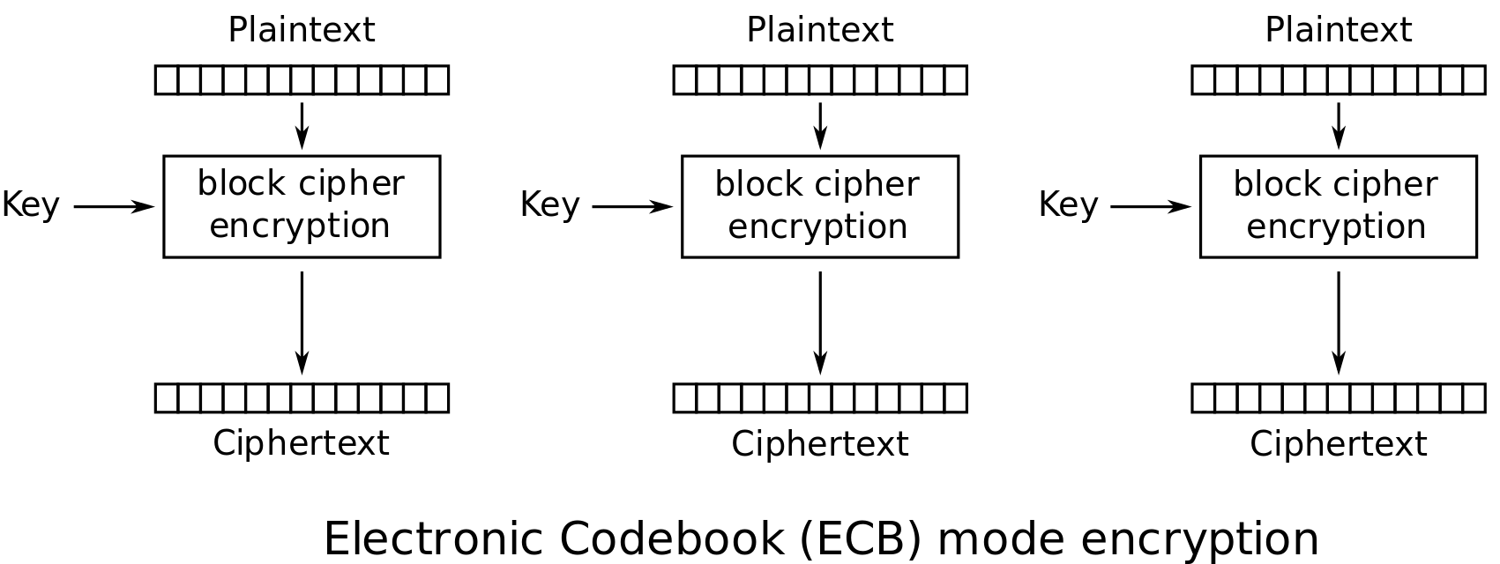
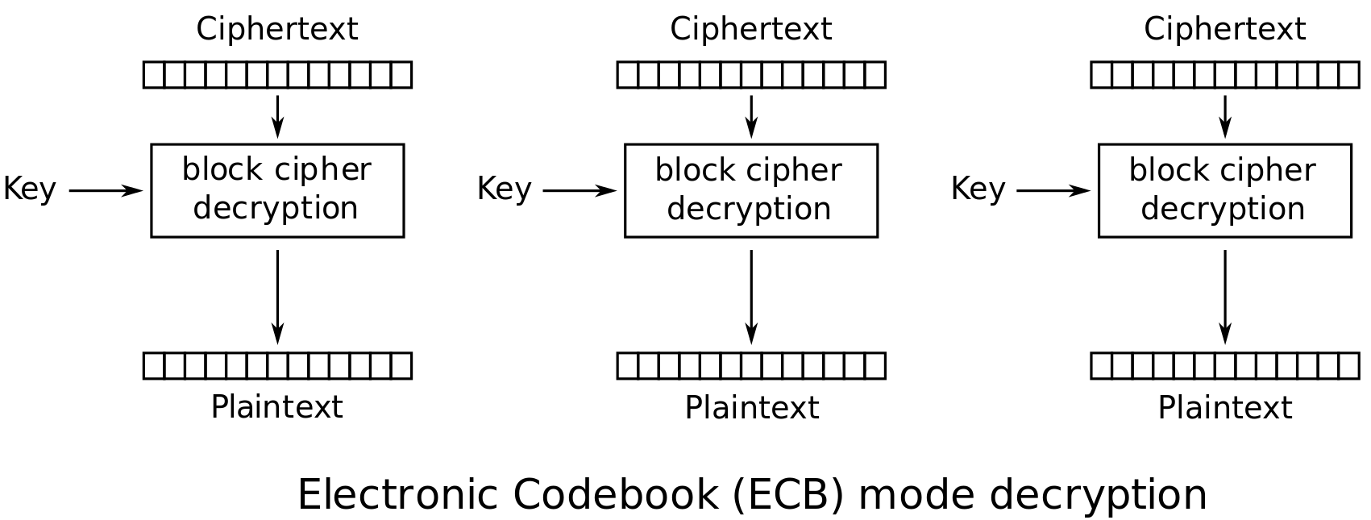
Electronic Code Book (ECB) Mode
lack of diffusion
m1 = m2 ⟶ c1 = c2
Notes:
The simplest of the encryption modes is the Electronic Codebook (ECB) mode.
The message is divided into blocks, and each block is encrypted separately.
The disadvantage of this method is a lack of diffusion. Because ECB encrypts identical plaintext blocks into identical ciphertext blocks, it does not hide data patterns well.

Slide 34


What can possibly go wrong?
Plaintext
Ciphertext
bitmap image
Images from Wikipedia
Notes:
Encrypt a bitmap image which uses large areas of uniform color
While the color of each individual pixel is encrypted, the overall image may still be discerned, as the pattern of identically colored pixels in the original remains in the encrypted version.

Slide 35
ECB Mode: Analysis
Pros:
Simple.
Tolerates blocks lost in transit.
Easy to parallelize.
Cons:
Identical plaintext blocks result in identical ciphertext ⇒ data patterns aren’t hidden.

Slide 36
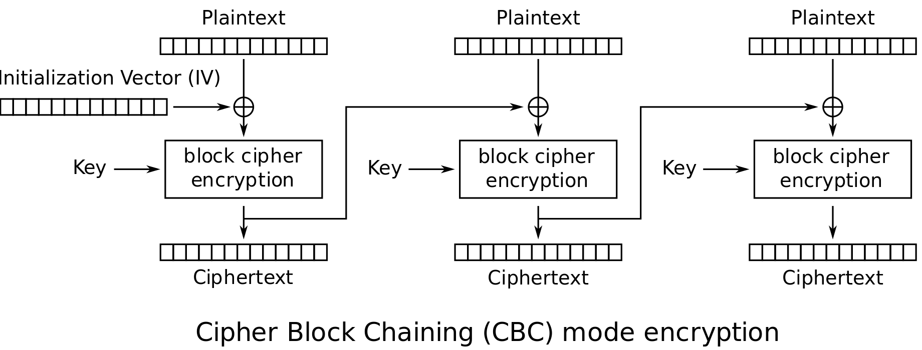
Cipher block chaining mode (CBC)
In CBC mode, each block of plaintext is XORed with the previous ciphertext block before being encrypted
An initialization vector (IV) is a block of bits that is used by several modes to randomize the encryption and hence to produce distinct ciphertexts even if the same plaintext is encrypted multiple times, without the need for a slower re-keying process
Notes:
This way, each ciphertext block depends on all plaintext blocks processed up to that point.
To make each message unique, an initialization vector must be used in the first block.
An initialization vector (IV) is a block of bits that is used by several modes to randomize the encryption and hence to produce distinct ciphertexts even if the same plaintext is encrypted multiple times, without the need for a slower re-keying process
The IV does not need to be kept secret and must be communicated to the receiving party along with the ciphertext.

Slide 37
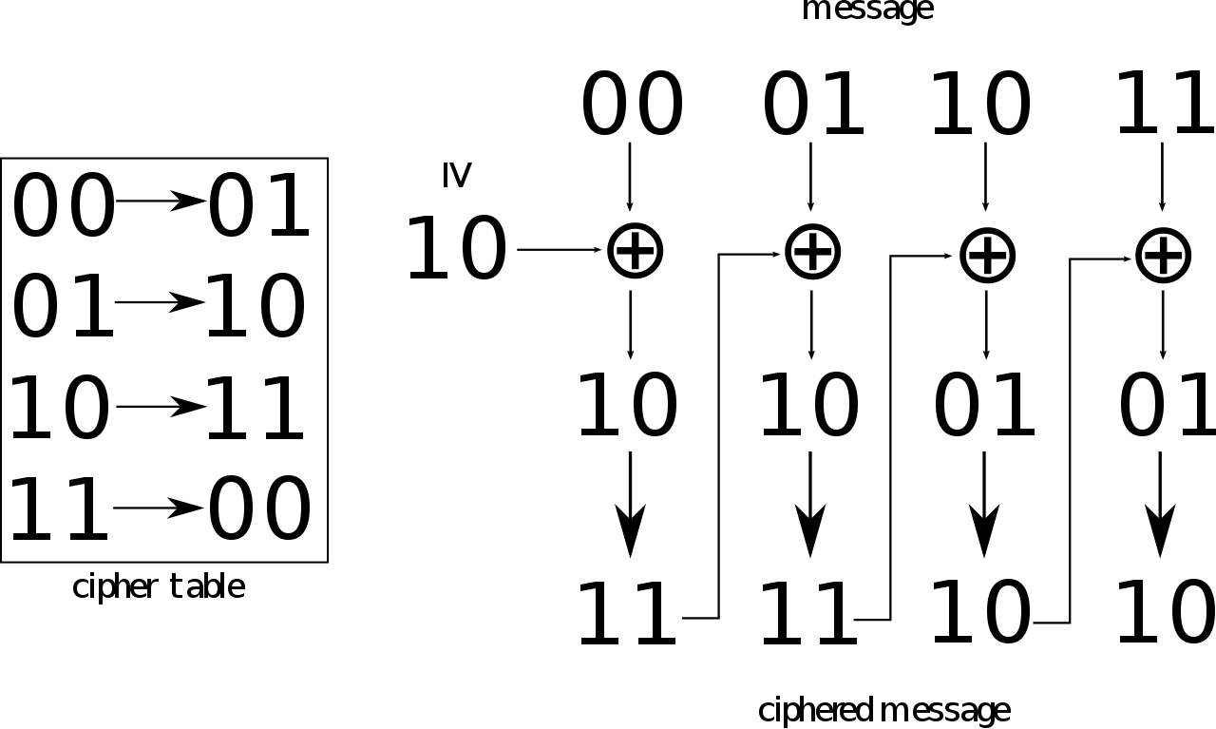
Cipher block chaining mode (CBC): example
Notes:
Its main drawbacks are that encryption is sequential (i.e., it cannot be parallelized)

Slide 38
CBC Mode: Analysis
Pros:
Identical plaintext blocks will yield different ciphertext blocks.
If block C_{i} is lost, C_{i+1} can’t be decrypted, but C_{i+2} can.
Cons:
Encryption can’t be parallelized.
Most commonly used mode of operation.
A one-bit change in a plaintext or IV affects all following ciphertext blocks.

Slide 39

Example – why CBC is good?
Tux
Tux encrypted with AES in CBC mode

Slide 40
Building Secure MACs
Given: a PRF for shorter messages (e.g., 16 bytes)
Goal: build a MAC for longer messages (e.g., gigabytes)
Construction examples:
CBC-MAC: Turn small PRF into big PRF

Slide 41
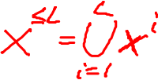
Construction 1: encrypted CBC-MAC
raw CBC
m[0]
m[1]
m[3]
m[4]
⊕
⊕
⊕
F(k,⋅)
F(k,⋅)
F(k,⋅)
F(k,⋅)
Let F: K × X ⟶ X be a PRP
Define new PRF F_{ECBC} : K² × X^{≤L} ⟶ X
F(k₁,⋅)
tag
we do one more encryption step. And this step is actually done using an independent key, k1
Notes:
ECBC for short
We start by taking our message and breaking it into blocks. Encrypt the first block and then feed the results into the XOR with the second block and then feed that into f again…...
Finally, we get the CBC outputs of this long chain.
Then, I would like to point your attention to the fact that we do one more encryption step. And this step is actually done using an independent key, k1. That’s different and chosen independently of the key K, and finally the output gives us the tag.
So you might be wondering what this last encryption step is for. And I will tell you that the function that’s defined without this last encryption step is called the raw CBC function.
And we will see in a minute, raw CBC is actually not a secure MAC. So the last step is actually critical for making the MAC secure.

Slide 42
Construction 2: NMAC (nested MAC)
cascade
m[0]
m[1]
m[3]
m[4]
k
t
F
F
F
F
>
>
>
>
t ll fpad
F
k₁
>
Let F: K × X ⟶ K be a PRF
Define new PRF F_{NMAC} : K² × X^{≤L} ⟶ K
tag
Notes:
The NMAC starts from PRF that takes inputs in X, but outputs elements in the key space. And remember that for CBC, the output has to be in the set X.
Which takes pairs of keys as inputs, again, can process variable length messages up until L blocks.
What comes out is the key for the next block of NMAC.
Just as before, in fact, if we stop here, the function that we obtain is called cascade function. It is not secure.
To get a secure MAC, what we do is we need to map this element t, into the set X. And so, typically, where the block length, X, is much bigger than the key length. What we do is we simply append fixed pad,
Finally, the last tag is an element of K which we output as the output of NMAC

Slide 43
Why the last encryption step in ECBC-MAC and NMAC?
NMAC: suppose we define a MAC I = (S,V) where
S(k,m) = cascade(k, m)
This MAC is secure
This MAC can be forged without any chosen msg queries
This MAC can be forged with one chosen msg query
This MAC can be forged, but only with two msg queries
Notes:
The reason is, if you’re given the output of the cascade function applied to a message m.
I can derive from the cascade applied to the message M concatenated W for any message W.
First of all, it should be clear that this is enough to mount an existential forgery because essentially by asking for a tag on m, I obtain the tag on this longer message which I can then output as my forgery.
Mac is insecure because given a MAC in one message, I can produce the MAC in another message.

Slide 44
Construction 2: NMAC (nested MAC)
cascade
m[0]
m[1]
m[3]
m[4]
W
F
t’
k
t
F
F
F
F
>
>
>
>
t ll fpad
F
k₁
>
Let F: K × X ⟶ K be a PRF
Define new PRF F_{NMAC} : K² × X^{≤L} ⟶ K
tag
cascade(k, m) cascade(k, m||w) for any w
Notes:
Attacker can add one more block here, then the attacker can take the output of cascade, which is the value t.
And we can simply apply the function F to it again.

Slide 45
Why the last encryption step in ECBC-MAC?
Suppose we define a MAC I_{RAW} = (S,V) where
S(k,m) = rawCBC(k,m)
Then I_{RAW} is easily broken using a 1-chosen msg attack.
Notes:
Show you that without this extra encryption block, ECBC is insecure
Let’s define a map that uses raw CBC, without the last encryption step

Slide 46
Construction 1: encrypted CBC-MAC
raw CBC
m[0]
m[1]
m[3]
m[4]
W
⊕
⊕
⊕
⊕
???
F(k,⋅)
F(k,⋅)
F(k,⋅)
F(k,⋅)
F(k, .)
???
Let F: K × X ⟶ X be a PRP
Define new PRF F_{ECBC} : K² × X^{≤L} ⟶ X
F(k₁,⋅)
tag
Notes:
Now the attacker wants to extend and compute the MAC on some message M, concatenated on with some message W.
But he doesn’t know what this key K is. And as a result, he doesn’t know what the output of the function is.
So he simply can’t just depend on block W, and compute the value of raw CBC on N concatenated W.
However, it turns out that he can actually evaluate this function. By using the chosen message attack.

Slide 47
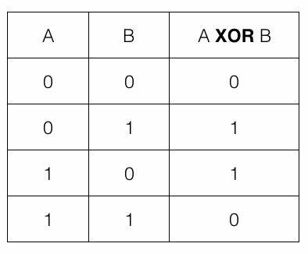
Why the last encryption step in ECBC-MAC?
Then I_{RAW} is easily broken using a 1-chosen msg attack.
Adversary works as follows:
Choose an arbitrary one-block message m∈X
Request tag for m. Get t = F(k,m)
Output t as MAC forgery for the 2-block message (m, t⊕m)
Indeed: rawCBC(k, (m, t⊕m) ) = F(k, F(k,m)⊕(t⊕m) ) = F(k, t⊕(t⊕m) ) = t
Notes:
The attacker starts by requesting the tag on a particular message m that’s a one-block message.
And now I claim that he can define this message m’, which contains two blocks.
And I claim that the value t he just received is a valid tag for this two block message, m’.
So the attacker can produce the valid t for this two block message that he never queried.

Slide 48
Recap: message integrity
So far, two MAC constructions:
ECBC-MAC: commonly used with AES
NMAC : basis of HMAC
PRFs
H-MAC: MACs from collision resistance hash functions.
Notes:
Collision resistance, which plays an important role in providing message integrity.
Our end goal is to describe a very popular MAC algorithm called Hmac that’s widely used in Internet protocols.
Hmac itself is built from collision resistant hash functions.

Slide 49
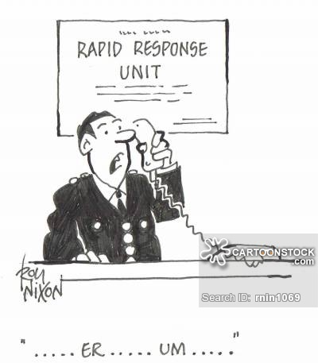
Introduction to Hash
A dictionary of street address
(3670), Cincinnati | (5411), Hamilton | (0022), Mason | (3313) (Brook) | (2174) (Cook) | (3305) Oxford | ……
0 | 1 | 2 | 3 | 4 | 5 | 6
“3305 !”
Hash Function h(x): index is last digit of x
3305
5: get content in a[5]
phone number is the search key
Hope! Find your location immediately!

Slide 50
Typical Hashing: Imperfect
99
555-9999:
…
555-5790:
555-7880
555-0170: address 1 555-2870: address 2 555-3870: address 3
…… ……
555-3860
……
555-8230
……
555-0000: add 100
Most hash functions are not perfect,
Can allow more than one search key to map into a single index
Causes a collision in the hash table
getHashIndex(555-0170) = 70
getHashIndex(555-2870) = 70 also!!!
getHashIndex(555-3870) = 70 also!!!
90
80
70
60
30
0
FIGURE 22-2 A collision caused by the hash function h

Slide 51
Collision Resistance
pigeonhole principle
Let H: M →T be a hash function ( |M| >> |T| )
A collision for H is a pair m₀ , m₁ ∈ M such that:
H(m₀) = H(m₁) and m₀ ≠ m₁
A function H is collision resistant if for all algs. A:
Adv_{CR}[A,H] = Pr[ A outputs collision for H]
is “negligible”.
Example: SHA-256 (outputs 256 bits)
Notes:
What does it mean for a hash function to be collision resistant.
Collision: for m0 and m1, when we apply the hash function to them they happen to collide and they both map to the same output in the tag space
We say that the function H is collision resistant if it’s hard to find collisions for this function.
This should seem a little bit counterintuitive because we know that the output space is tiny compared to the input space so by the pigeonhole principle there must be lots of messages map to the same outputs, because isn’t enough space in the output space to accommodate all the messages without collisions.
We know that there are lots of collisions and the question is that it is easy to find an efficient algorithm that finds any such collisions.
We say that the function is collision resistant if for all explicit algorithms A, then these algorithms are not able to print a collision for the function H.
A classic example of a collision resistant hash function is sharp 256 which happens to output 256 bits but can take arbitrary large inputs.
Nobody knows how to find collisions for this particular function.

Slide 52
MACs from Collision Resistance
Let I = (S,V) be a MAC for short messages over (K,M,T) (e.g. AES)
Let H: M^{big} → M
Def: I^{big} = (S^{big} , V^{big} ) over (K, M^{big}, T) as:
S^{big}(k,m) = S(k,H(m)) ; V^{big}(k,m,t) = V(k,H(m),t)
Thm: If I is a secure MAC and H is collision resistant then I^{big} is a secure MAC.
Example: S(k,m) = AES_{2-block-cbc}(k, SHA-256(m)) is a secure MAC.
SHA-256: outputs 256 bits outputs
Notes:
Let’s see how we can trivially build a MAC given a collision resistant hash function.
Then we can define a new MAC, by applying the small MAC to the output of the hash function.
And how do we verify a MAC, by rehashing the given message and then checking that a small MAC actually verified under the given tag.
Example, SHA-256 outputs 256 bits outputs, which is 32 bytes so we have to build a mac that can MAC 32 byte messages, by applying two-block CBC. And two-block CBC would expand AES form a PRF on 16 bytes to a PRF on 32 Bytes.
The MAC example is secure assuming AES is a PRF and SHA-256 is collision resistance.

Slide 53
MACs from Collision Resistance
S^{big}(k, m) = S(k, H(m)) ; V^{big}(k, m, t) = V(k, H(m), t)
Collision resistance is necessary for security:
Suppose an adversary can find m₀ ≠ m₁ s.t. H(m₀) = H(m₁).
Then: S^{big} is insecure under a 1-chosen msg attack
step 1: adversary asks for t ⟵S(k, m₀)
step 2: output (m₁ , t) as forgery
Notes:
I want to pointed out is that in fact collision resistance is necessary for this construction to work. In fact, collision resistance is not just a made-up term. It really is kind of the essence of why this combined MAC is secure.
Let’s just assume that the hash function H is not collision resistance. In other words, there is an algorithm that can find two distinct messages that happen to map to the same output.
Actually, in the above case, the combined MAC is not going to be secure because what the adversary can do is simply use the chosen message attack to get a tag for m0 and then output the tag of m1 as a forgery and indeed t is also a valid MAC for m1 because H of m1 b happens to be equal to H of m0.
So we see the collision resistance is very useful primitive and that it lets us expand the input space.

Slide 54
Protecting file integrity using C.R. hash
Software packages:
read-only public space
package name
package name
package name
F₁
F₂
F_{n}
⋯
H(F₂)
H(F₁)
H(F_{n})
When user downloads package, can verify that contents are valid
H is collision resistant ⇒
attacker cannot modify package without detection
no key needed (public verifiability), but requires read-only space
Linux often use public spaces there they advertise hashes of their software and any one can make sure that they download right software before installing it on their computer.
Notes:
The user wants to download the software package and he wants to make sure that he really did get a version of the package that he download. No one modify.
Refer to a read-only public space: hold small hashes of these software packages.
Read only space: the attacker cannot modify the hashes stored in the space
Once he consults this public spaces, he can very easily compute the hash of a package that he download compare it to the value in the public space and if the two match then he know that’s a version of the package you download is in fact a correct one.
Because the function H is collision resistance, the attacker cannot find an f1’ that would have the same hash as f1 and as a result, the attacker cannot modify f1 without being detected.
We saw similar situation with MACs,. In the mac, we need a secret key to verify the individual tags but we didn’t need a resource that way a read-only public space with collision resistant hash.

Slide 55
Birthday Paradox
If there are 23 students in our classroom, what is the probability that at least 2 of them have the same birthday?
Try to Answer:
P₁: none of them have the same birthday
1 – P₁ : at least 2 of them have the same birthday
1st stu: 365/365
2nd stu: 346/365
3rd stu: 363/365
…
n^{th} stu: (365 - n + 1)
Pr(1 - P₁) =
1 – {365/365 * 364/365* … * (365-n+1)/365 }
when n = 23, Pr(1 - P₁) = 0.5
when n = 41, Pr(1 - P1) = 0.9
Notes:
find the opposing situation

Slide 56
Birthday Paradox
How can use birthday paradox to attack hash functions?
Let H: M →T be a hash function ( |M| >> |T| )
student space in our classroom
birthday space
Just need to try smaller size of input space, the attacker can find collision

Slide 57
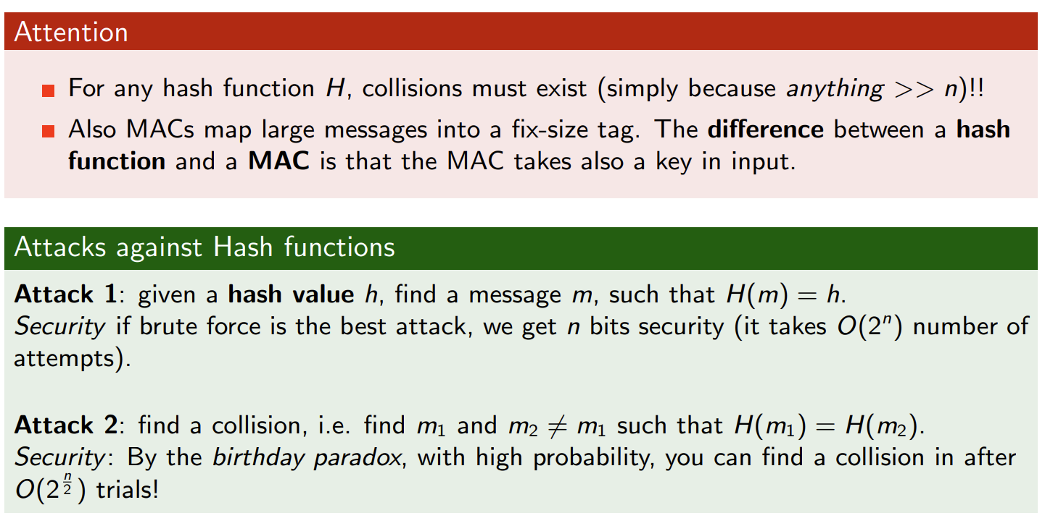
Birthday Paradox

Slide 58
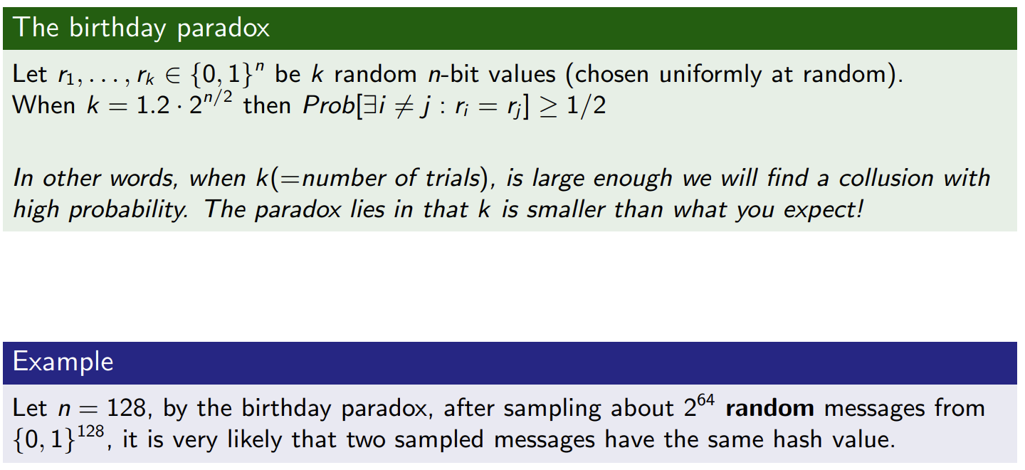
Birthday Paradox

